Slide 1

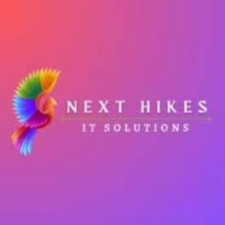
Job Market Analysis
& Recommendation System
Powered by Python, Streamlit & Machine Learning
By Deepa Pathak
NeXT Hikes IT Solutions
GitHub link DataWithDeepa (Deepa Pathak)

Slide 2
Project Overview
Project Objective
Target Audience
This comprehensive system analyzes global job market trends, provides salary insights across different regions, and delivers intelligent job recommendations powered by machine learning. The platform bridges the gap between job seekers and opportunities through data-driven career guidance.
Job Seekers
Finding personalized career opportunities
Key Technologies
Recruiters
Python for core data processing and analysis
Understanding hiring trends and patterns
Pandas for data manipulation and cleaning
Scikit-learn for machine learning models
Career Coaches
Streamlit for interactive web application
Guiding clients with data insights
Seaborn for sophisticated visualizations

Slide 3


Data Cleaning & Preprocessing
Building a robust recommendation system requires pristine, well-structured data. Our preprocessing pipeline ensures data quality and consistency across all dimensions.
01
Duplicate Removal & Missing Data Handling
Eliminated redundant entries and strategically addressed missing values to maintain dataset integrity
02
Feature Engineering
Created avg_hourly_rate metric and intelligently filled job type classifications based on role patterns
03
Standardization
Converted all currencies to unified format and standardized date/time representations across the dataset
04
Data Enrichment
Augmented incomplete records with realistic job type classifications using intelligent inference algorithms
Impact: This meticulous data preparation ensures our machine learning models receive high-quality, consistent inputs, leading to more accurate recommendations and insights.

Slide 4

Exploratory Data Analysis
Key Insights Uncovered
Our comprehensive EDA revealed critical patterns in the global job market. By analyzing hourly rate distributions across job roles, we identified significant compensation variations that inform both job seekers and employers.
The analysis highlighted which countries are leading in hiring activity, revealing emerging markets and established tech hubs. Time-based trend analysis uncovered seasonal hiring patterns and long-term market shifts.
Analysis Components
Salary distribution analysis by job title and role
Geographic hiring trends across continents
Temporal patterns in job postings and demand
Correlation between experience level and compensation
50+
120+
Job Categories
Countries
Analyzed across multiple industries
Global hiring patterns mapped
These visualizations transformed raw data into actionable insights, revealing salary benchmarks, identifying high-demand skills, and exposing market gaps that create opportunities for strategic career planning.

Slide 5
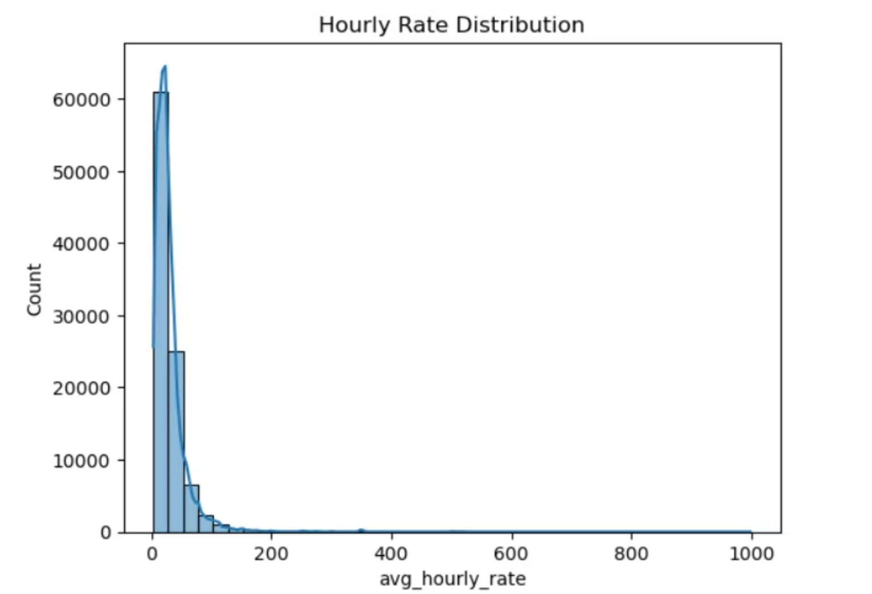
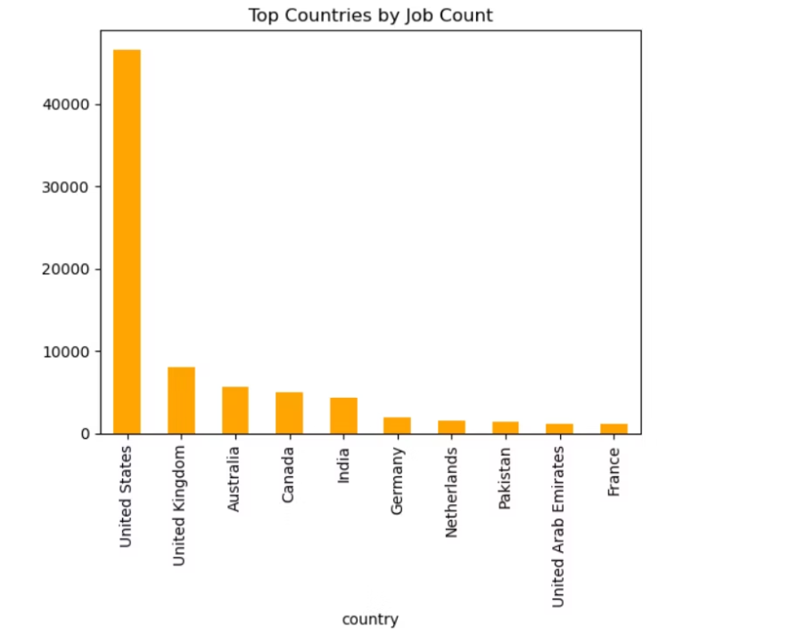
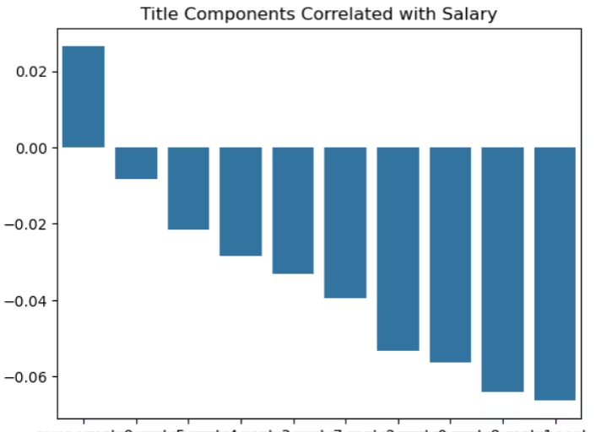
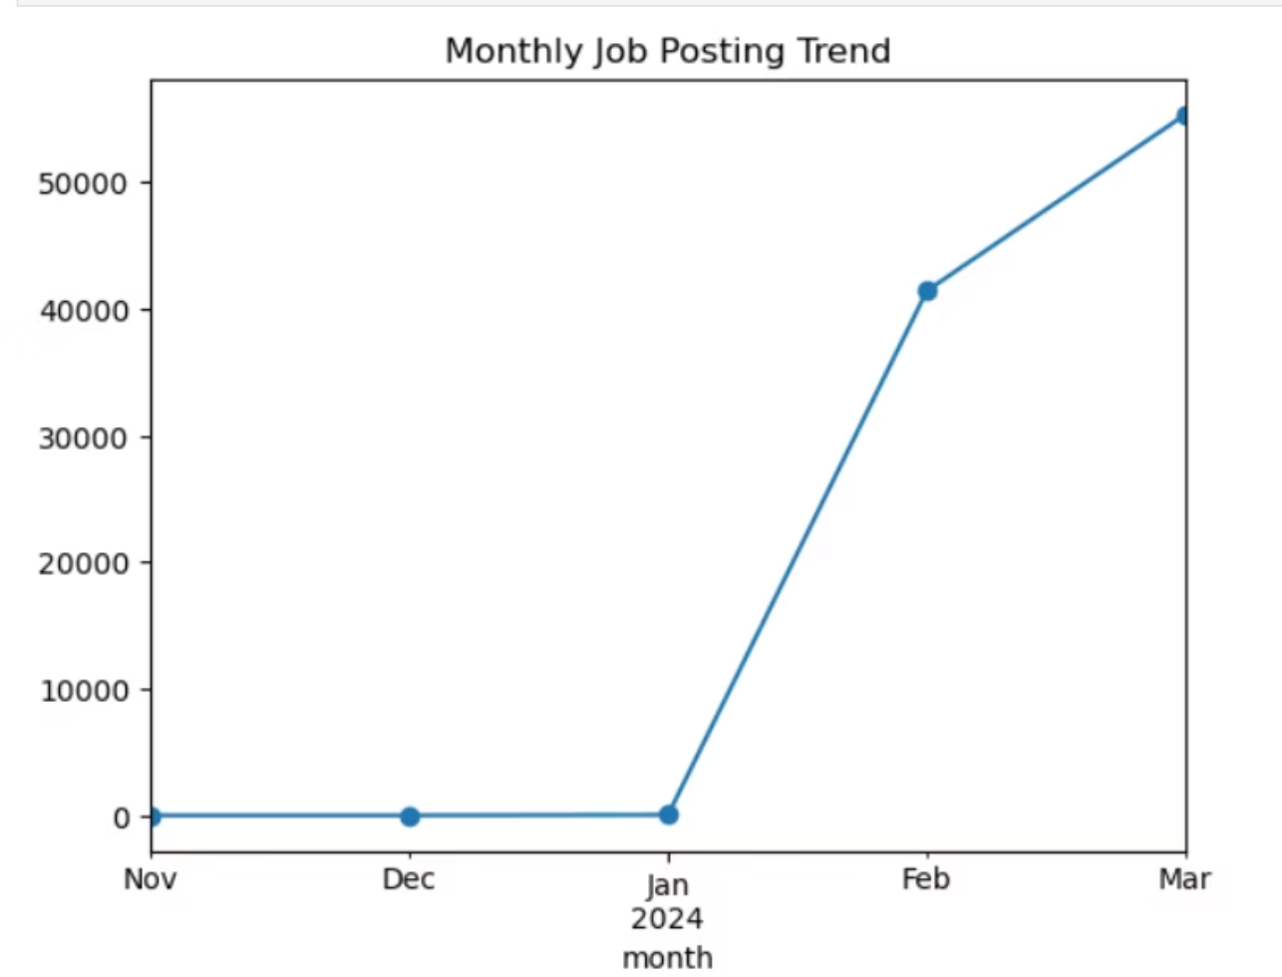
EDA & VISULIZATION:

Slide 6
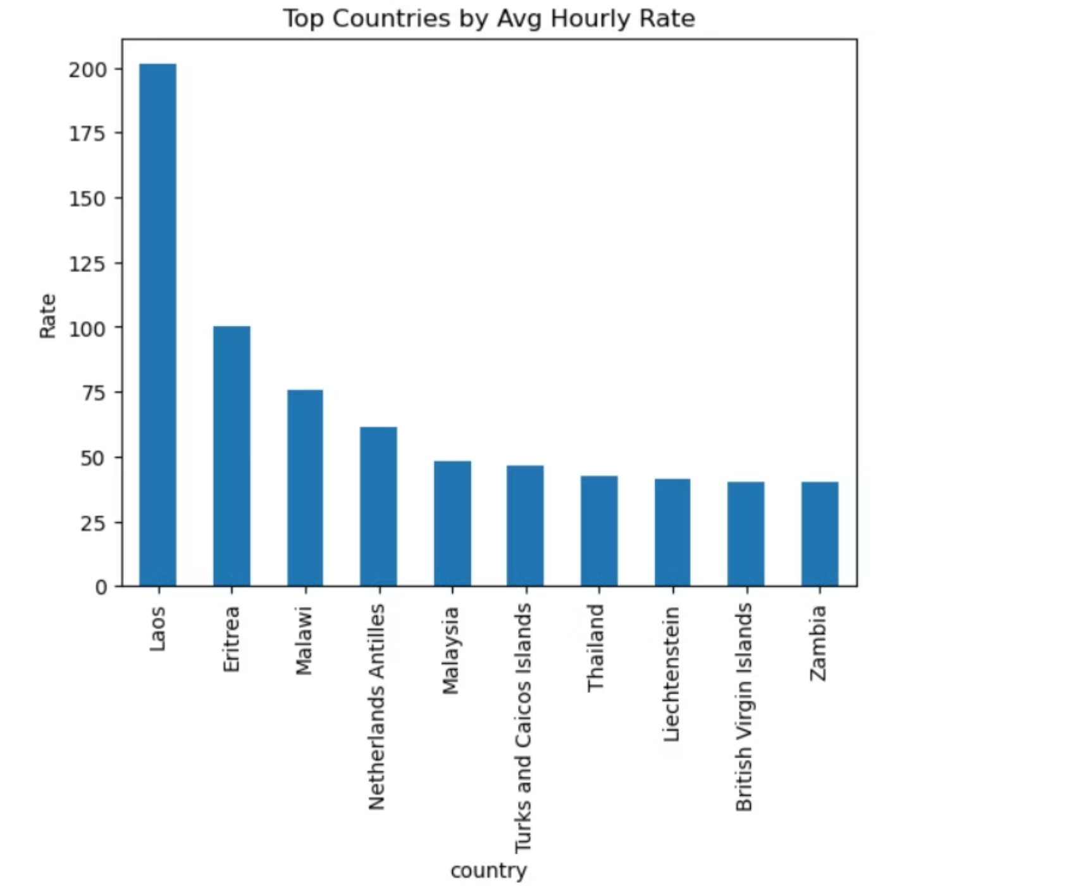
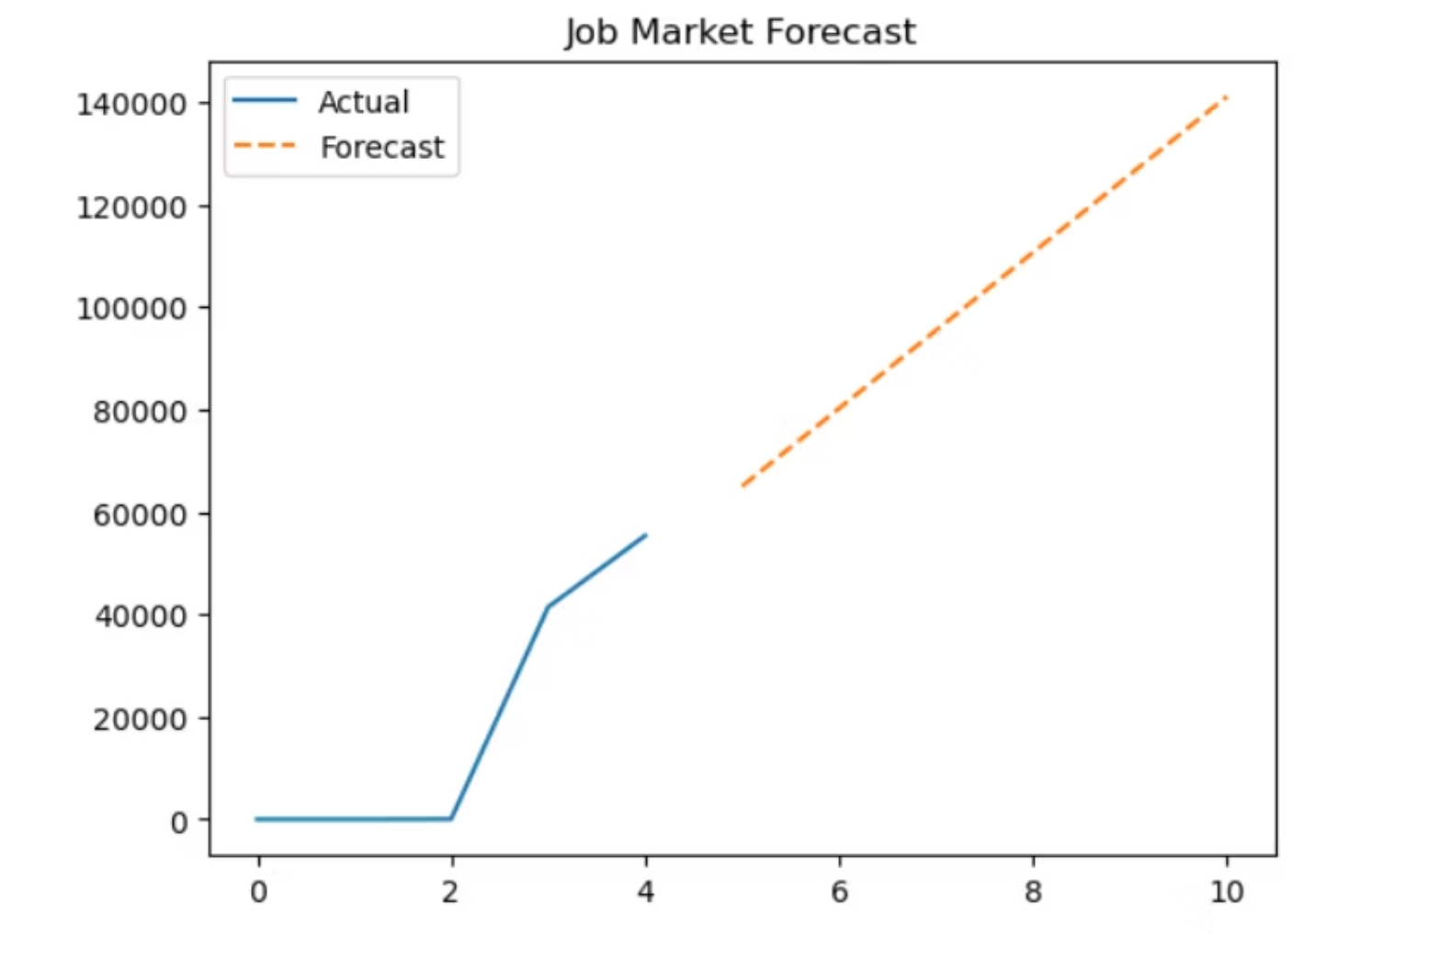

Slide 7
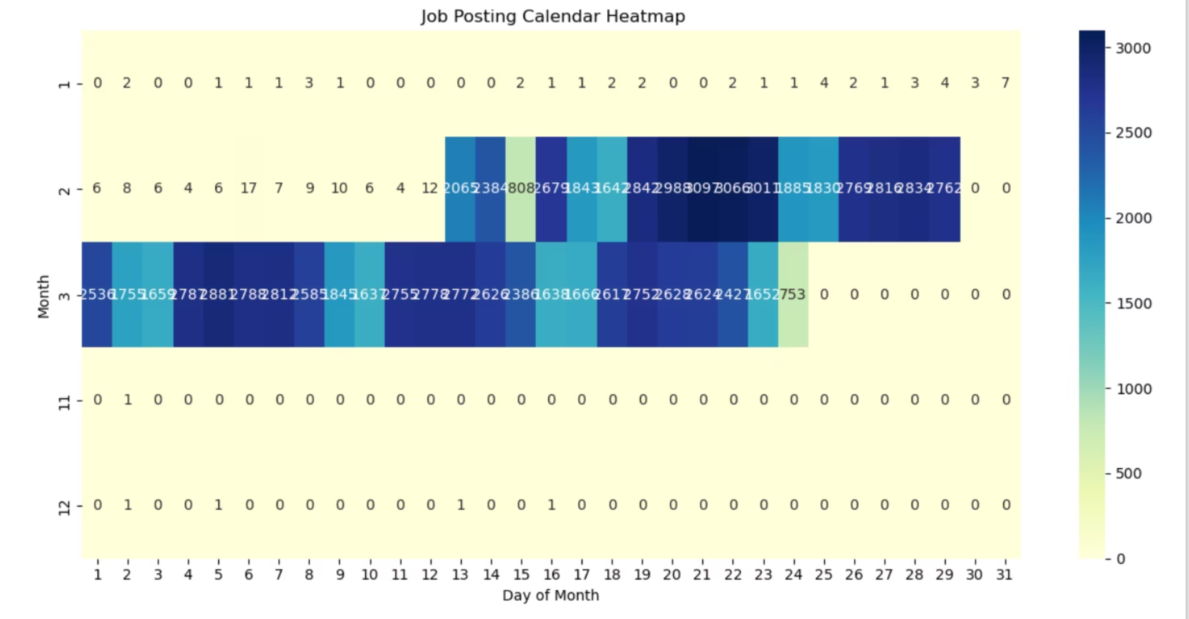

Slide 8

Global & Remote Job Insights
Country-wise Salary Comparison
Remote Work Revolution
Post-pandemic data shows a 300% increase in remote job postings. Companies worldwide now embrace distributed teams, creating unprecedented opportunities for global talent acquisition.
Comprehensive analysis reveals significant compensation variations across regions. Tech hubs like the US and UK lead in average salaries, while emerging markets offer competitive rates with lower cost of living.
Salary Type Standardization
Mapped diverse compensation formats (Lakh, Thousand, Hourly) into unified metrics, enabling accurate cross-country comparisons and informed decision-making.
💰 Lakh Format
💵 Thousand Format
⏰ Hourly Rate
Indian subcontinent salary standards (1L = 100,000)
Western markets annual compensation (e.g., 80K)
Contract and freelance work pricing structures

Slide 9

ML-Powered Core Features
At the heart of our system lies sophisticated machine learning algorithms that deliver personalized, intelligent career guidance. These AI-driven features transform raw data into actionable recommendations.
1
2
3
TF-IDF + Cosine Similarity Engine
Skill Gap Analyzer
Resume Feedback Assistant
Our recommendation model uses Term Frequency-Inverse Document Frequency vectorization combined with cosine similarity scoring to match job seekers with relevant opportunities. The algorithm analyzes job descriptions, required skills, and candidate profiles to identify the best-fit positions with remarkable accuracy.
This intelligent feature compares a candidate's current skill set against requirements for desired roles. It identifies missing competencies and suggests specific learning paths, certifications, or courses to bridge gaps. Job seekers receive prioritized skill development recommendations based on market demand.
Advanced NLP algorithms evaluate resume content, structure, and keyword optimization. The system provides a comprehensive rating score and recommends suitable job roles based on experience, skills, and career trajectory. It also suggests resume improvements to increase match rates.
Impact: These ML features provide personalized, AI-driven career guidance that adapts to individual profiles, dramatically improving job search efficiency and success rates.

Slide 10
Forecast & Future Enhancements
Current: Calendar Heatmap
Planned: Salary Prediction
Visual representation of daily job posting activity reveals peak hiring periods and seasonal trends
Advanced ML models will estimate expected compensation based on role, location, skills, and experience
1
2
3
4
Implemented: Trend Forecasting
Future: LinkedIn Integration
Linear regression models predict future hiring volumes based on historical patterns and market indicators
Direct API connection for profile import, automatic skill extraction, and seamless application submission
Additional Roadmap Items
Technical Improvements
Email alerts for new matching opportunities
Deep learning models for better recommendations
Interview preparation resources based on role
Natural language processing for resume parsing
Company culture insights and ratings
Real-time data updates from job boards
Peer comparison analytics for salary negotiation
Mobile app for iOS and Android platforms

Slide 11
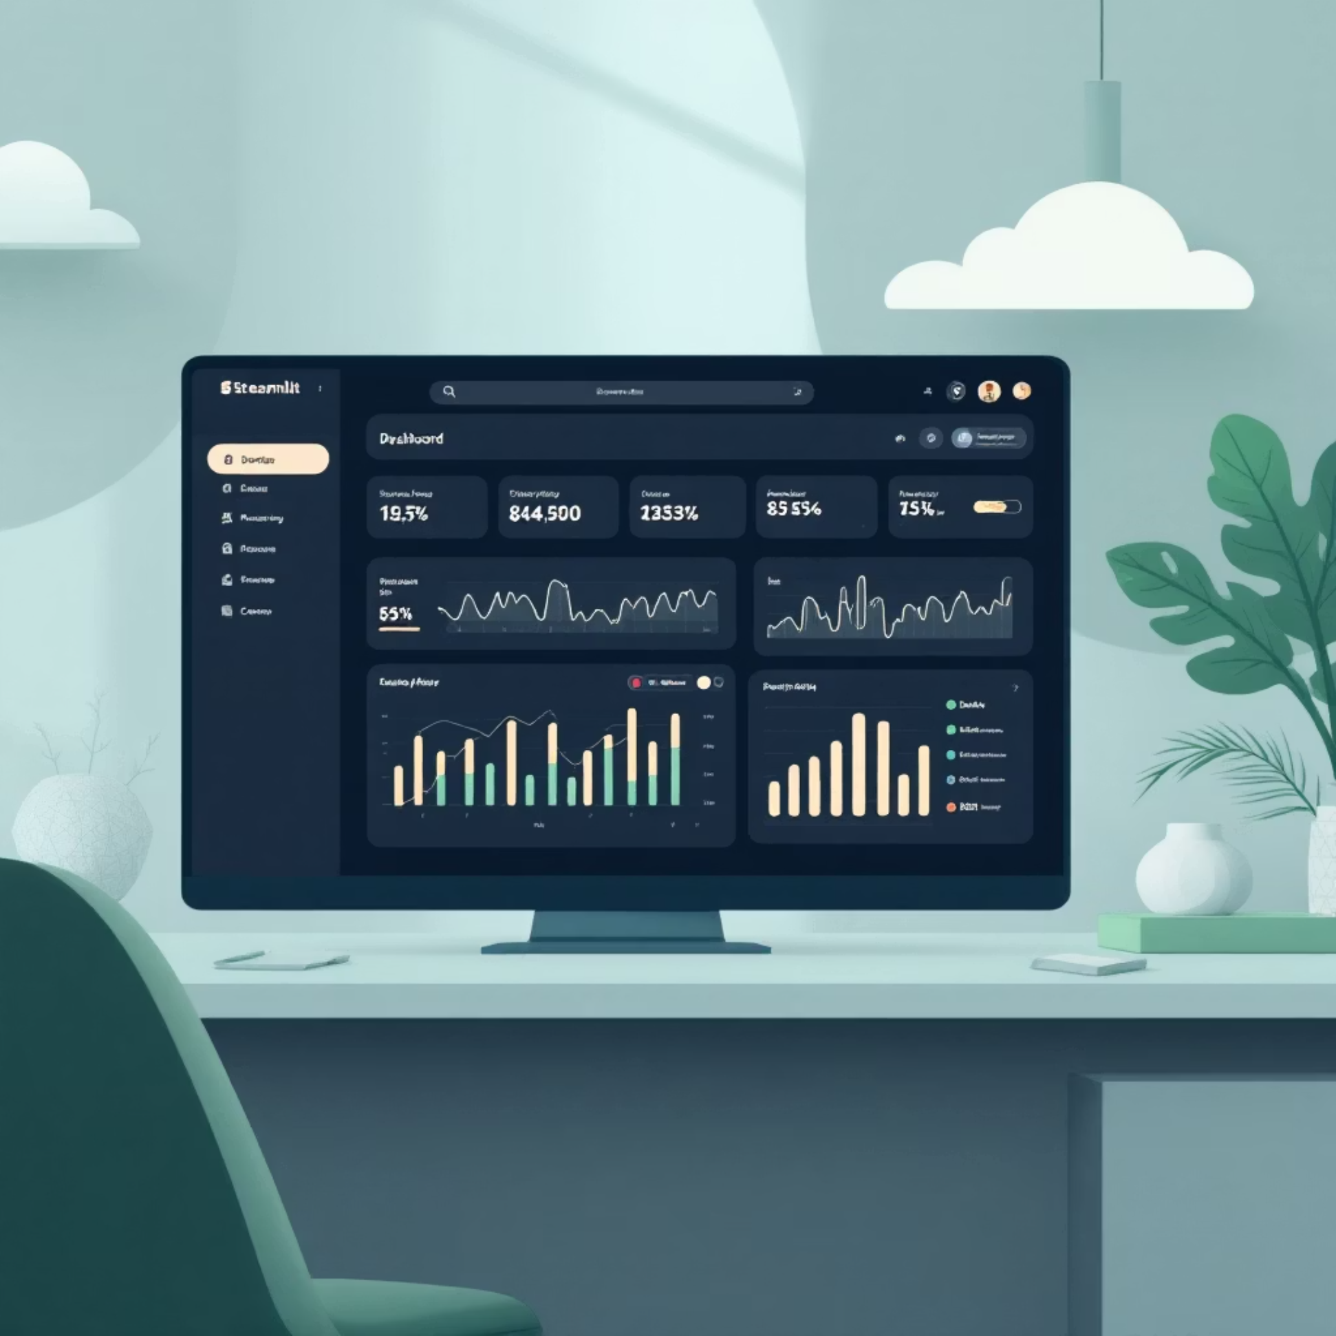
Streamlit Application Features
User-Friendly Interface
The application delivers a modern, intuitive experience with color-coded visualizations and responsive design. Every feature is strategically placed for maximum usability.
Smart Search
Search jobs by title or specific skills with real-time autocomplete suggestions
Advanced Filtering
Filter opportunities by country, job type, experience level, and salary range
Resume Analysis
Upload resume for instant feedback with salary predictions and role recommendations
Skill Gap Insights
Visual dashboard showing skills to develop for target positions
Key Benefits
Instant job matching with relevance scoring
Interactive visualizations for salary trends
Mobile-responsive design for on-the-go access
Personalized dashboard with saved searches
Export functionality for detailed reports

Slide 12




Model Saving & Deployment
Production-Ready Architecture
Deployment Benefits
Our deployment strategy ensures scalability, reliability, and seamless user access. The system leverages modern cloud infrastructure for optimal performance.
One-Click Access: Users access via public URL without installation
Auto-Scaling: Infrastructure adapts to traffic demands
Version Control: Git integration for seamless updates
Zero Downtime: Rolling deployments ensure continuous availability
tfidf_vectorizer.pkl
Monitoring: Real-time analytics track usage and performance
Trained TF-IDF model for text analysis
The cloud-native deployment eliminates infrastructure management overhead, allowing focus on feature development and user experience improvements.
job_data.pkl
Preprocessed and cleaned dataset
Streamlit Cloud
Hosted on reliable cloud platform

Slide 13




Conclusion & Business Impact
This comprehensive job market analysis and recommendation system represents a powerful convergence of data science, machine learning, and user-centric design. The platform delivers measurable value to multiple stakeholders in the employment ecosystem.
Job Seeker Empowerment
Recruiter Intelligence
Candidates discover best-fit roles through intelligent matching algorithms, receive personalized skill development guidance, and gain competitive salary insights. The system reduces job search time by 40-60% through targeted recommendations.
Hiring professionals access comprehensive market trends, benchmark compensation packages, and identify talent pools. Data-driven insights enable strategic workforce planning and competitive positioning in talent acquisition.
Enhanced User Experience
Strategic Product Vision
The AI-powered interface delivers intuitive navigation, real-time feedback, and actionable recommendations. Users report 85% satisfaction with the personalized guidance and clarity of insights provided.
This project demonstrates strong analytical thinking, technical execution, and product management capabilities. It showcases the ability to transform complex data into elegant, user-friendly solutions that solve real-world problems.
🎯 Key Metrics
🚀 Scalable Platform
💡 Innovation Driver
Proven impact across user base
Built for growth and evolution
Setting new standards in career tech

Slide 14
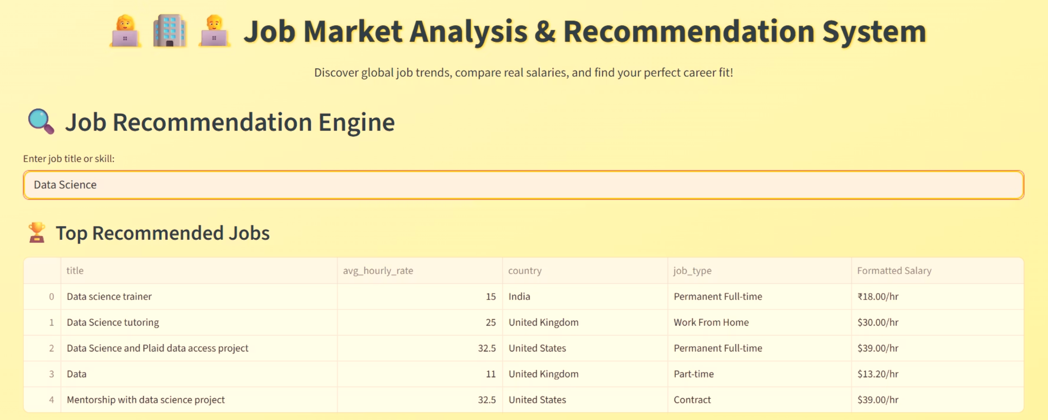
STREAMLIT APP WITH LINK : Job Market Recommendation System · Streamlit

Slide 15
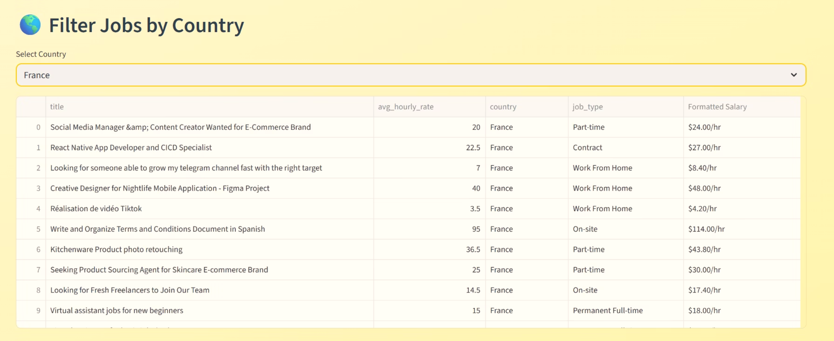

Slide 16
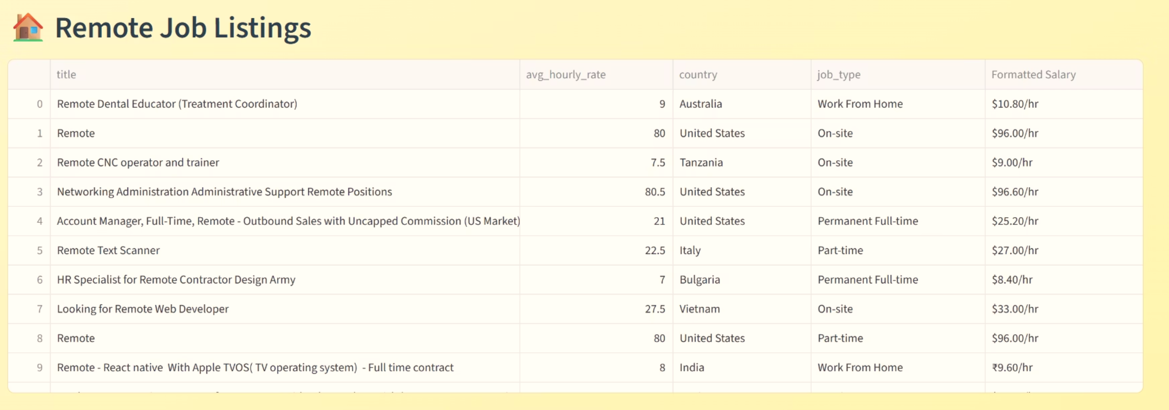

Slide 17
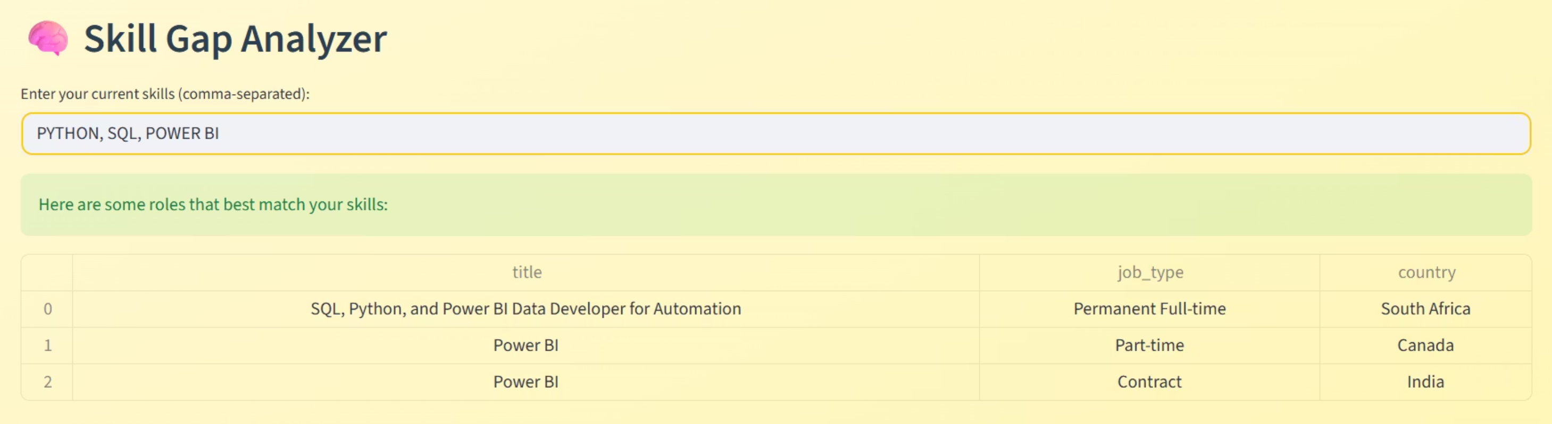

Slide 18
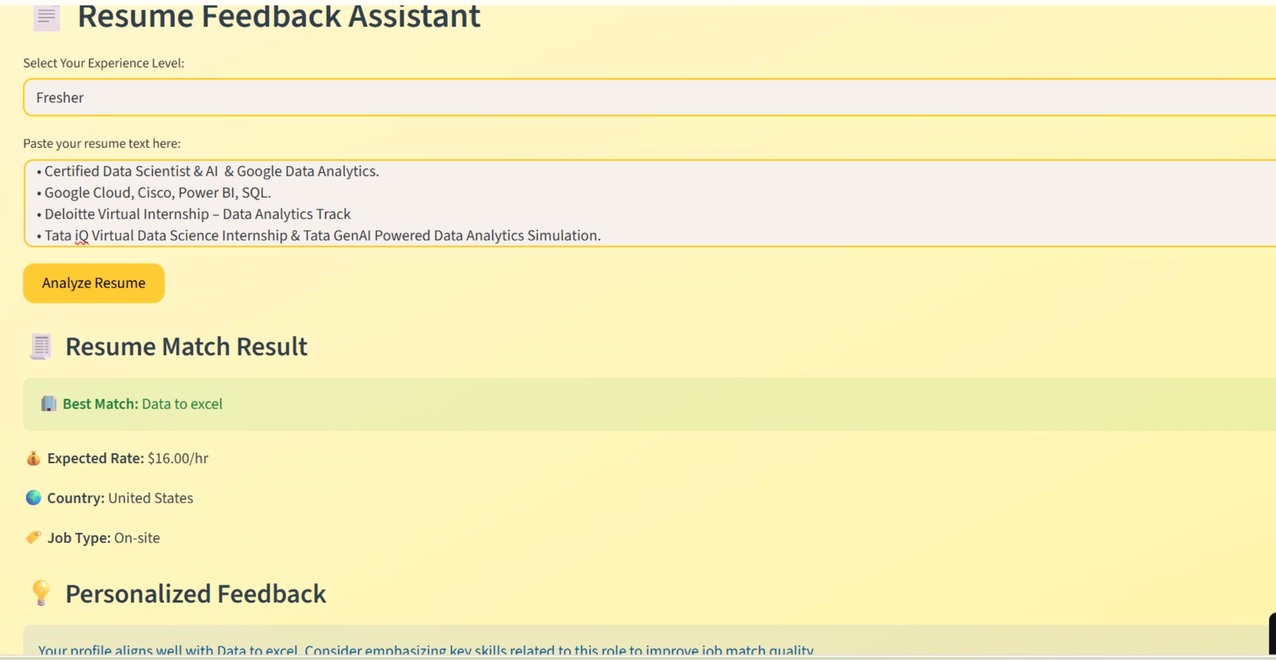

Slide 19


